Slide 1

Spectral Clustering
Presented by:
Media Salih
Matina Rahbar
Mebrooka Rayyana
Dr. Alginahi Nov 10, 2023

Slide 2
Table of Contents
Introduction
Challenges
Process
Advantages and Disadvantages
Applications
Examples

Slide 3
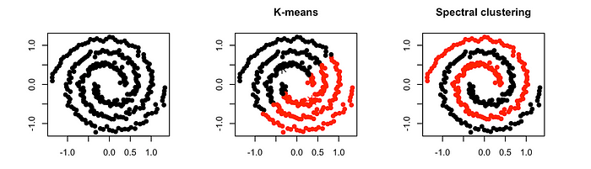
What is Spectral Clustering?
Data clustering technique that identifies groups of similar data points by leveraging the eigenvalues and eigenvectors of a similarity graph.
Two ways to approach clustering:
Compactness: Points that are in close proximity to one another belong to the same cluster
Connectivity: Points that are linked or directly adjacent to one another are grouped into the same cluster
Source: https://tinyurl.com/5ekmrpz2
Notes:
Compactness: Points that are in close proximity to one another belong to the same cluster and are densely packed around the center of that cluster. The level of closeness can be quantified by assessing the distance between the individual observations.
Connectivity: Points that are linked or directly adjacent to one another are grouped into the same cluster. Even if the distance between two points is small, if they are not directly connected, they won't be clustered together. Spectral clustering is a method that adheres to this principle.

Slide 4
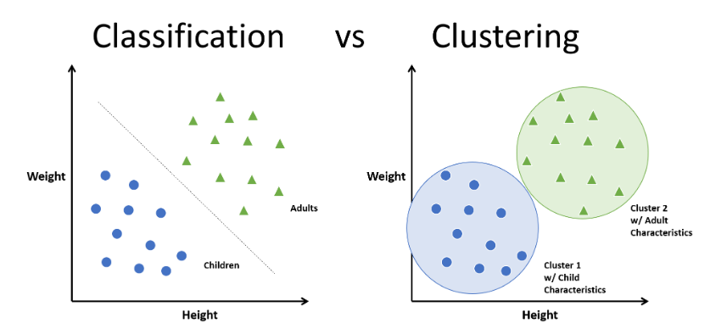
Clustering Vs Classification
Source: https://tinyurl.com/e5se3zp3
Notes:
As humans, in machine learning, a widely used unsupervised algorithm to group unlabeled data points by similarity and distance measures is clustering. If the data points are labeled, grouping is known as classification.

Slide 5
Why Spectral Clustering?
Handling complex cluster shapes
Non-linear separability
Graph-based representation
Sensitivity to connectivity
Community detection in networks
Image segmentation
Dimensionality reduction
Unsupervised learning
Versatility in data
Robustness to noise and outliers

Slide 6
Challenges of Traditional Clustering
Sensitivity to initial centroids
Assumption of equal-sized cluster
Assumption of spherical clusters
Difficulty with non-linear relationships
Outlier sensitivity
Influence of noise
Difficulty with varying clusters densities
Fixed number of clusters
Limited capability for graph data

Slide 7

Process: Affinity Matrix Construction
Given a dataset with n data points, a matrix A is constructed.
This matrix encodes the pairwise similarity between data points.
Common similarity measures include Gaussian similarity (based on a radial basis function)
Or k-Nearest Neighbors (where A_{ij} is non-zero if data points i and j are among the k nearest neighbors of each other).
Or kernel

Slide 8
Process: Degree Matrix
For each row in the affinity matrix, sum up the values to get the total similarity or degree of connection for each data point.
The degree matrix D is a diagonal matrix where each diagonal element represents the degree of the corresponding node in the graph.
If A is the affinity matrix, then the degree matrix D is formulated as Djj =∑j Aij , where i and j represent row and column indices, respectively.

Slide 9
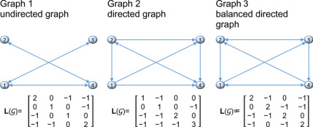
Process: Laplacian Matrix
The Laplacian matrix is derived from a graph, where nodes represent data points, and edges represent the relationships between these points. L = D - A
Source: https://tinyurl.com/2t5tz7bx

Slide 10
Process: Eigenvalue Problems
Eigenvalues characterize the behavior of the linear transformation associated with the matrix.
In spectral clustering, eigenvalues convey information about the underlying structure and connectivity of the data.
Smaller eigenvalues correspond to more global patterns, while larger eigenvalues capture finer, more local patterns.
Notes:
Eigenvalues represent scalar values that characterize the behavior of the linear transformation associated with the matrix.

Slide 11
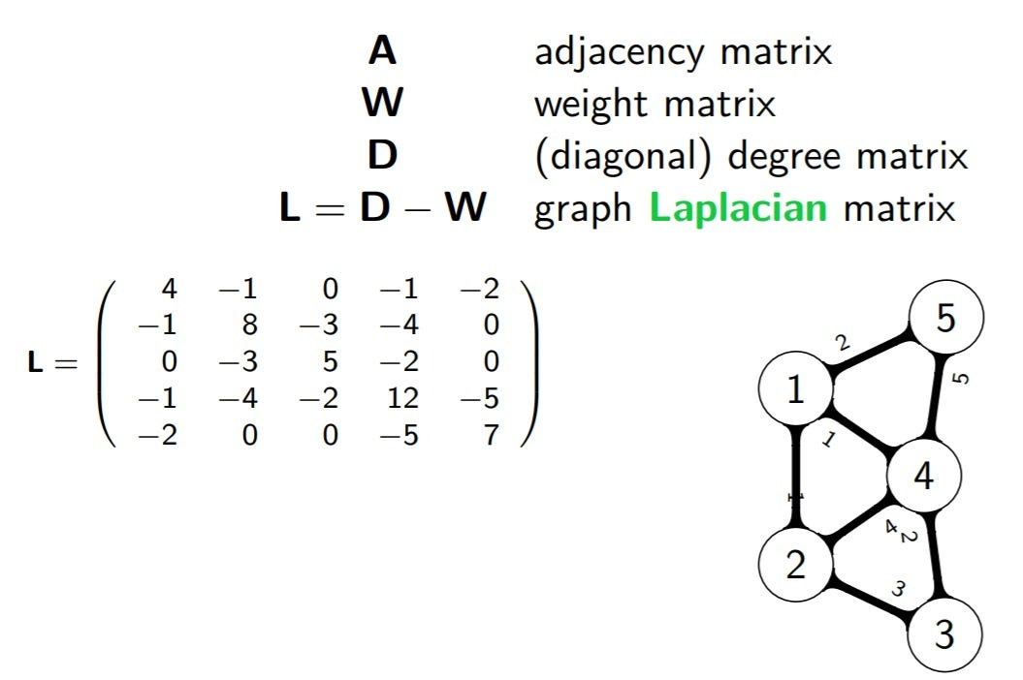
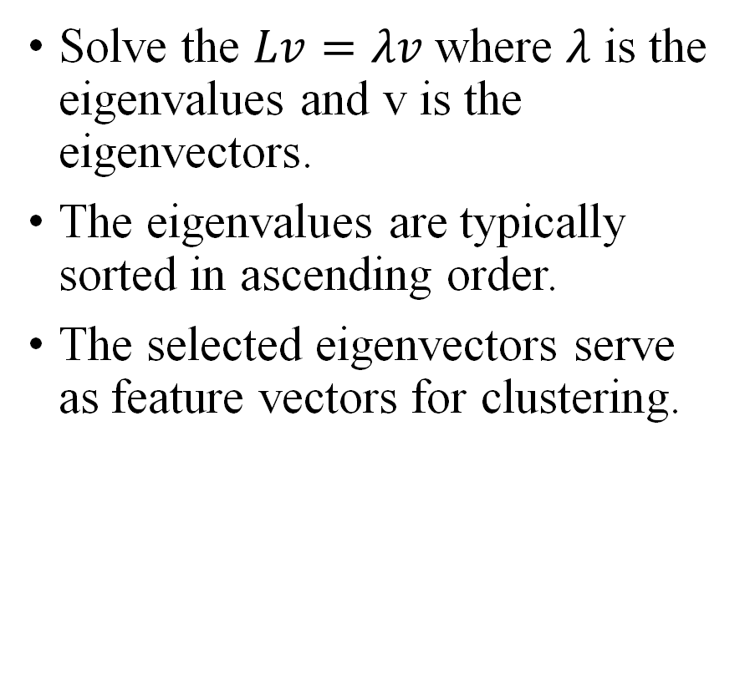
Process: Eigenvector Calculation
Solve the $Lv=λv$where $λ$ is the eigenvalues and v is the eigenvectors.
The eigenvalues are typically sorted in ascending order.
The selected eigenvectors serve as feature vectors for clustering.
Source: https://tinyurl.com/65sbbx7p
Notes:
Select the first k eigenvectors corresponding to the smallest k eigenvalues. The value of k is chosen based on the desired number of clusters.

Slide 12
Process: Embedding
By using eigenvectors as features, spectral clustering operates in a reduced-dimensional space, potentially enhancing the separation of clusters.
The computed eigenvectors serve as a new set of features for the data points.
Each data point is represented as a vector in this new space, often referred to as the spectral embedding.
Notes:
Represent the original data in the reduced-dimensional space by concatenating the selected eigenvectors into a matrix U. Each row of U corresponds to a data point in the new feature space.

Slide 13
Process: Clustering in Embedded Space
K-means can then be applied to the embedded data points to group similar data points into clusters.
These algorithms work in lower-dimensional space defined by the spectral embedding
It's important to specify the number of clusters (k) before applying traditional clustering techniques.
Assign data point to the cluster with the highest probability based on the output.
Notes:
Apply a standard clustering algorithm (e.g., K-means) to the rows of U to group the data points into clusters. The number of clusters is determined by the value of k selected previously.
Assign each data point to the cluster with the highest membership probability based on the clustering algorithm's output.

Slide 14
Example
https://www.youtube.com/watch?v=rVnOANM0oJE&ab_channel=Udacity

Slide 15
Advantages of Spectral clustering
Facial Recognition: Spectral clustering identifies facial patterns using similarity graphs and eigenvalues.​
Advantages Over K-means: It excels in recognizing complex facial patterns and handling noise.​
High-Dimensional Data: Spectral clustering is effective in recognizing faces in high-dimensional feature spaces.

Slide 16
Disadvantages to Spectral Clustering
Parameter Sensitivity: Sensitivity to parameter settings, such as the number of clusters.
High Computational Cost: Computationally intensive, particularly for large datasets.
Limited Scalability in High Dimensions: May not work well in high-dimensional spaces without dimensionality reduction

Slide 17
Applications of Spectral Clustering
Face Clustering
Expression Analysis
Age Estimation
Gender Classification
Face Verification

Slide 18
Example
Scenario: We have a dataset of images, and we need to group together similar faces
Mathematical steps + programming:
Preprocessing: each m by n image is transformed into a mn-dimensional feature vector
Similarity Matrix Construction: Given n images, the similarity matrix W is a n×n matrix where Wij represents the similarity between images i and j

Slide 19
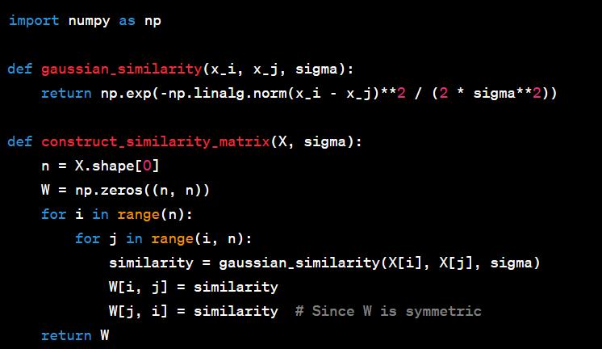
Example
Mathematical steps + programming:
Code:

Slide 20


Example
Mathematical steps + programming:
3. Degree Matrix: Calculate the degree matrix D, which is a diagonal matrix where Dii is the degree of data point i, i.e., the sum of its edge weights
4.Laplacian Matrix: Compute the Laplacian matrix L=D−W.

Slide 21

Example
Mathematical steps + programming:
5. Eigenvector Calculation: Compute the first k eigenvectors of the Laplacian matrix.
6. Spectral Embedding: The k eigenvectors form the spectral embedding. Each image is represented in the embedded space.

Slide 22
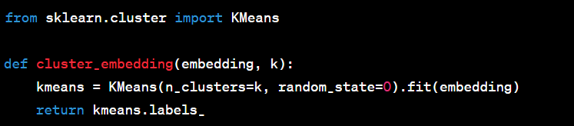
Example
Mathematical steps + programming:
7. Clustering: Apply a clustering algorithm to the embedded space. For example, use k-means clustering to group the images into k clusters.
8. Post-Processing and Interpretation: Analyze the clusters to see if they correspond to meaningful groupings of faces. For example, they might represent different individuals.

Slide 23
Reference
[1] N. Doshi, “Spectral clustering,” Medium, https://towardsdatascience.com/spectral-clustering-82d3cff3d3b7 (accessed Nov. 5, 2023).
[2] K. V, “Spectral clustering: A comprehensive guide for beginners,” Analytics Vidhya, https://www.analyticsvidhya.com/blog/2021/05/what-why-and-how-of-spectral-clustering/ (accessed Nov. 7, 2023).
[3] “Laplacian matrix,” Laplacian Matrix - an overview | ScienceDirect Topics, https://www.sciencedirect.com/topics/computer-science/laplacian-matrix (accessed Nov. 5, 2023).
[4] A. Aoullay, “Spectral clustering for beginners,” Medium, https://towardsdatascience.com/spectral-clustering-for-beginners-d08b7d25b4d8 (accessed Nov. 7, 2023).
[5] “Spectral clustering in machine learning,” GeeksforGeeks, https://www.geeksforgeeks.org/ml-spectral-clustering/ (accessed Nov. 7, 2023).

Slide 24
Questions?

